Slide 1




Custom WordPress Themes
Creating a Custom WordPress Themes using HTML, CSS and PHP
Custom WP
Themes
SoftUni Team
Technical Trainers
Software University
http://softuni.bg

Slide 2



Table of Contents
WP Themes – Structure
Starter Themes
Building a WP Theme
Selecting a Starter Theme
Customizing the CSS
Creating Page Templates
Creating Widget Areas and Menu Locations

Slide 3
Have a Question?
sli.do #web-basics

Slide 4
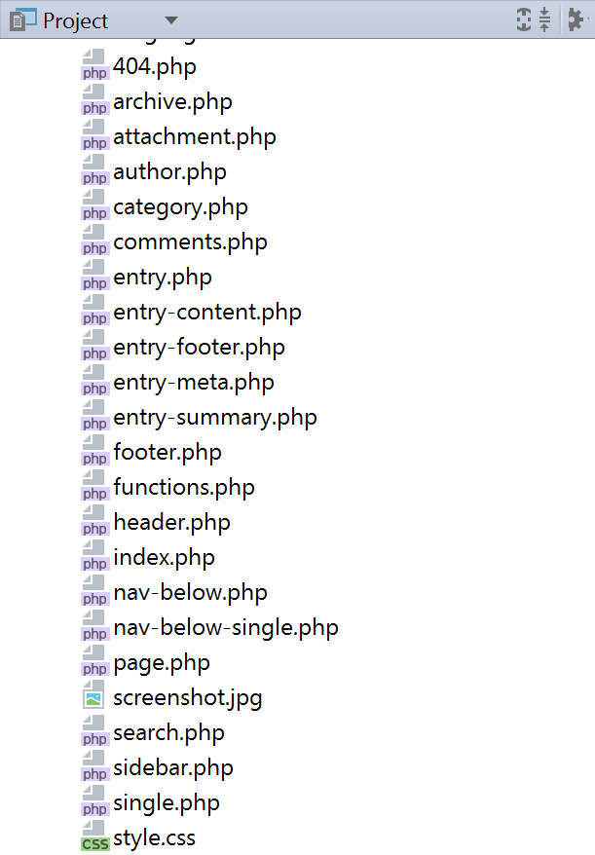
WordPress Themes – Structure
Themes Files and Structure

Slide 5
What's inside a WP Theme?
Typical WordPress themes consist of:
Header template – header.php
Footer template – footer.php
Sidebar template – sidebar.php
Posts template – index.php
Single post template – single.php
Page template – page.php
CSS styles – style.css
Theme functions – functions.php

Slide 6
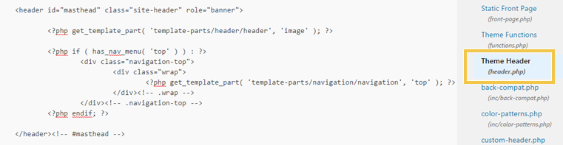
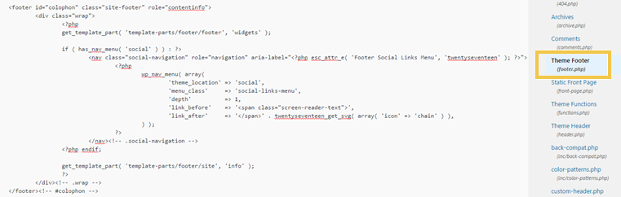
WordPress Theme Files: Header & Footer
header.php – displays the header at the top of pages / posts
footer.php – inserted at the bottom of all pages / posts

Slide 7
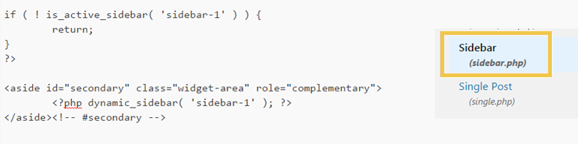
WordPress Theme Files: Sidebar
sidebar.php – displays the sidebar widgets
Shown at the left / right side of the posts / pages
Themes may display several widget areas in its sidebars

Slide 8
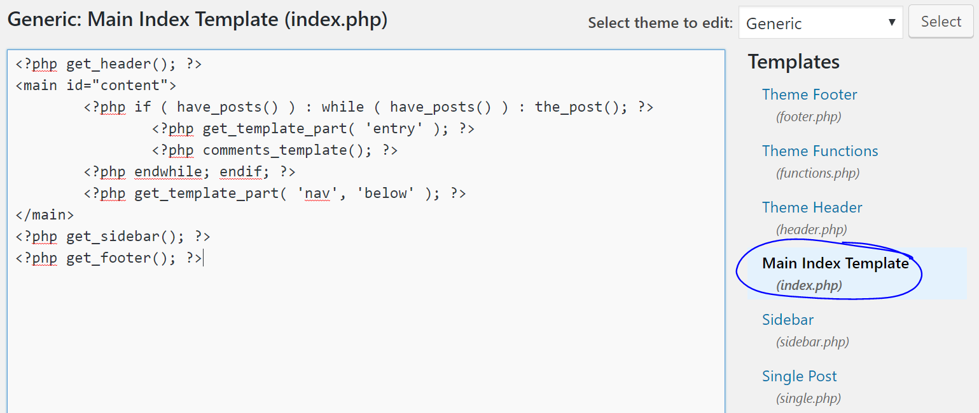
WordPress Theme Files: Posts
index.php – the main index template (lists all posts)
single.php – single post template (single post in details)

Slide 9
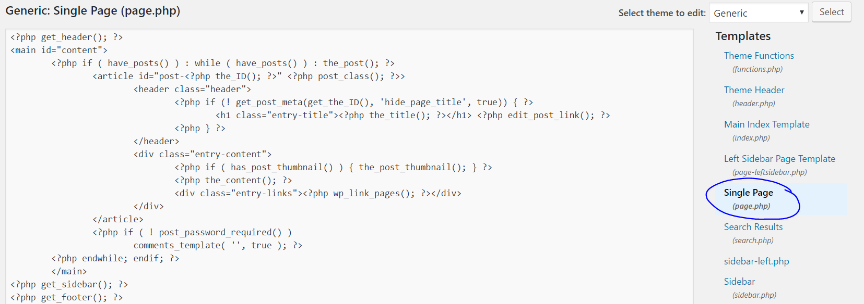
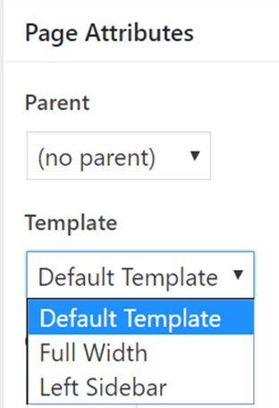
WordPress Theme Files: Pages
page.php – the default page template
page-full-width.php – another page template (full width)

Slide 10
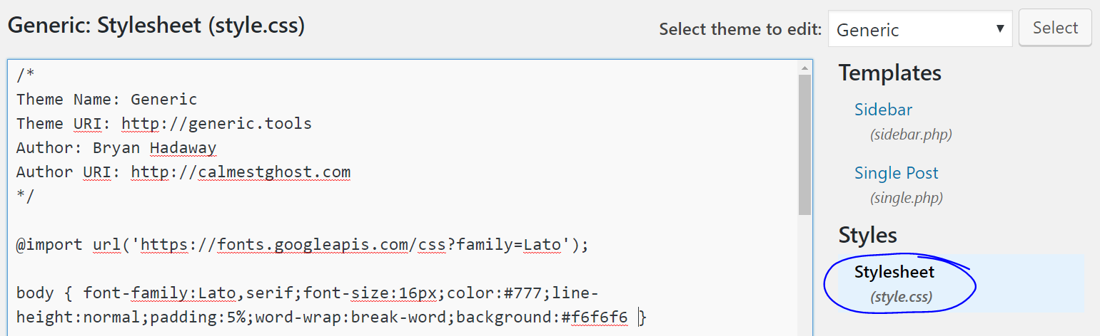
WordPress Theme Files: CSS Styles & Others
style.css – holds the theme CSS styles
Also holds the theme metadata (name, author, URL, license, …)
functions.php – theme functions, hooks, sidebar registrations, menu registrations, custom functionality

Slide 11
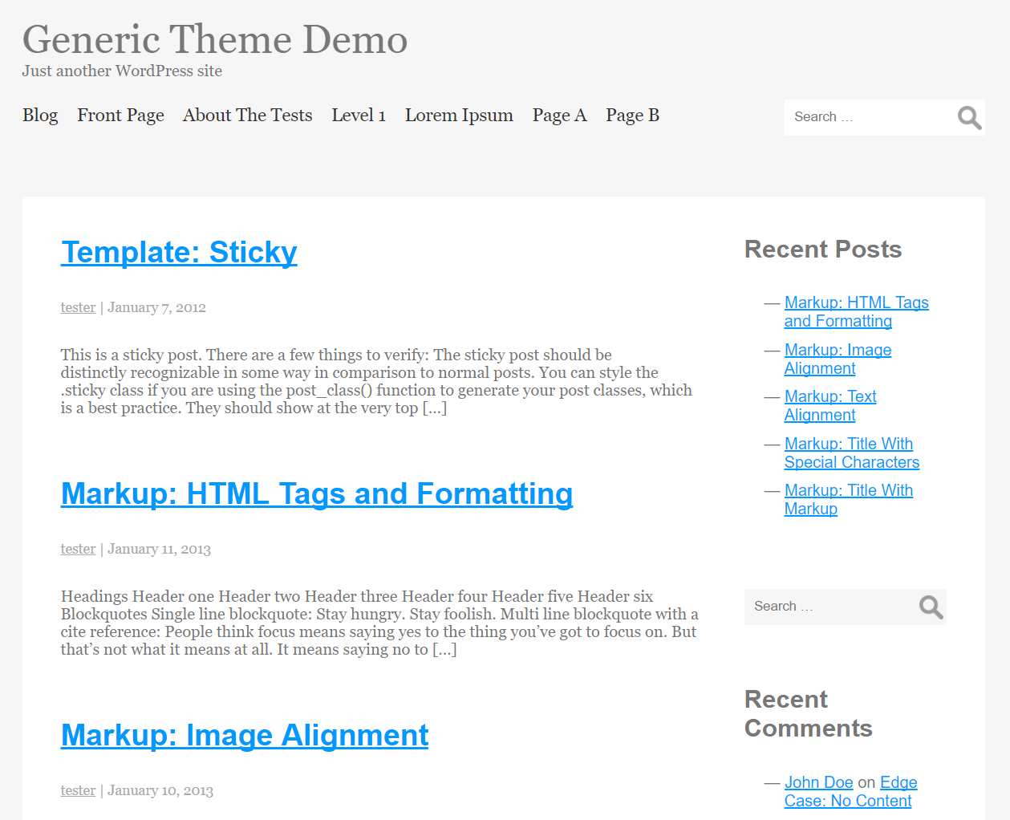
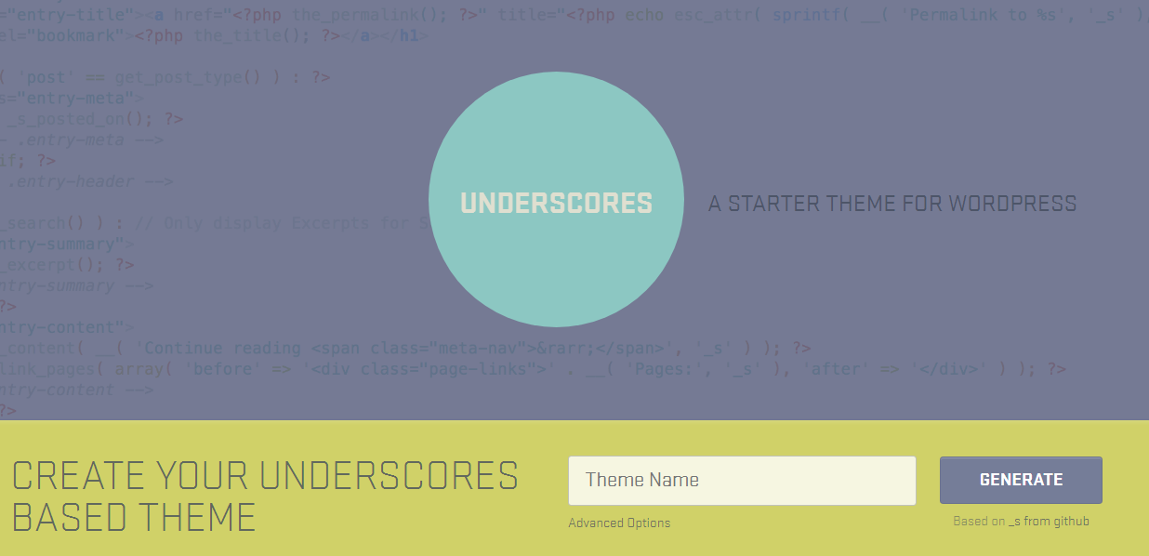
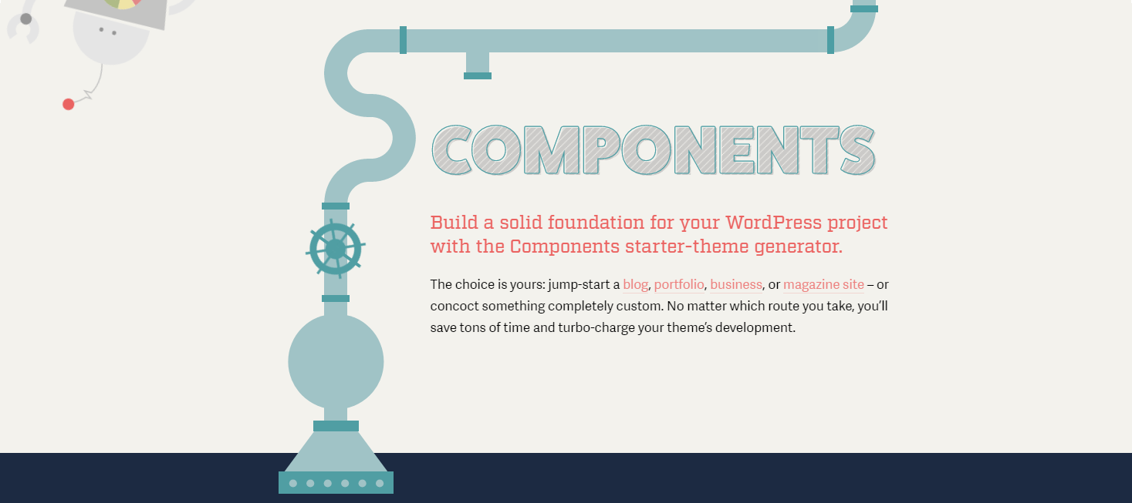
Starter Themes for WordPress
Use a Starter Theme as a Foundation

Slide 12
Starter WP Themes
Don't build WP themes from scratch!
Instead use a starter WP theme
Starter themes save time and introduce best practices
Well-known WordPress starter themes
http://generic.tools
http://components.underscores.me
https://wordpress.org/themes/understrap/
https://wordpress.org/themes/wp-rootstrap/
http://www.wpbeginner.com/wp-themes/21-best-wordpress-starter-themes-for-developers/

Slide 13
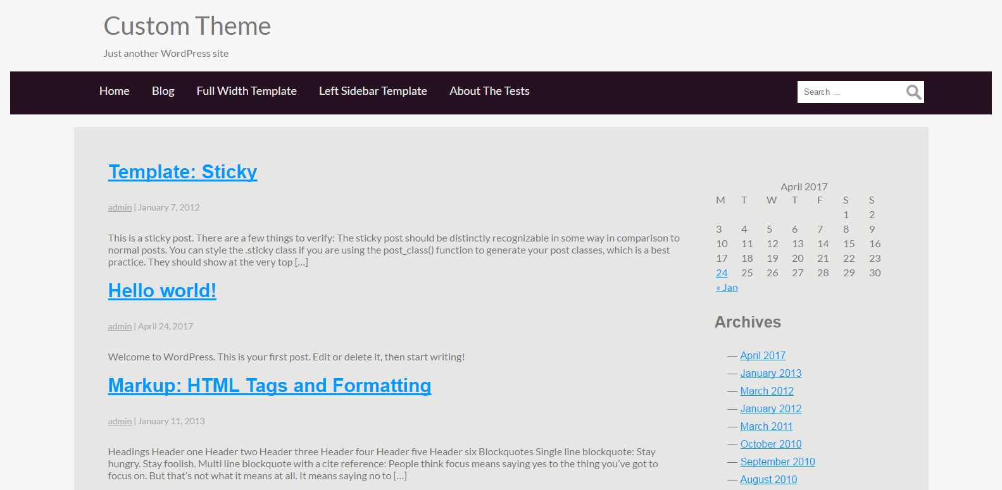
Building a Custom WP Theme
From Starter Theme to Better Theme

Slide 14
Start from a Starter Theme
We shall use the starter theme from http://generic.tools
"Generic" WP theme – https://wordpress.org/themes/generic/

Slide 15
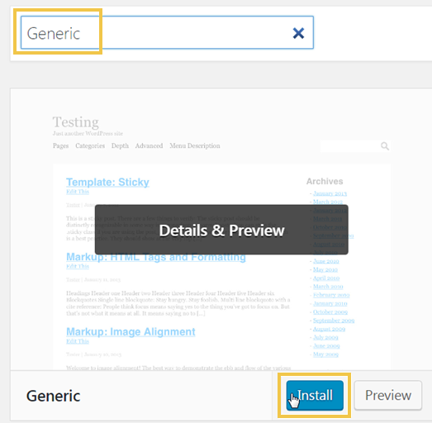
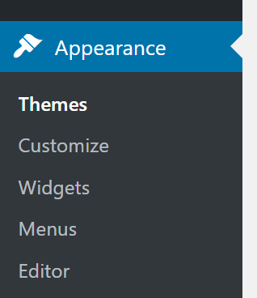
Install the "Generic" WP Theme
Install the "Generic" WP theme from the official WP theme directory

Slide 16
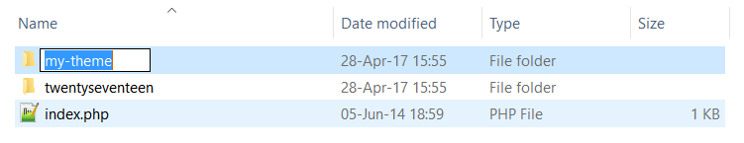
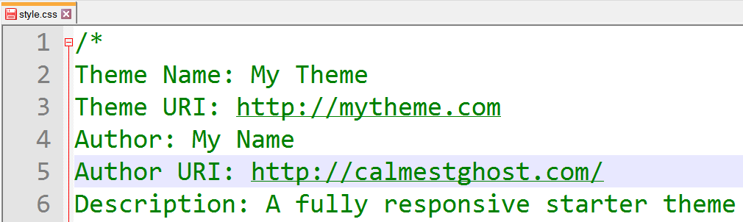
Rename Your Theme

Slide 17
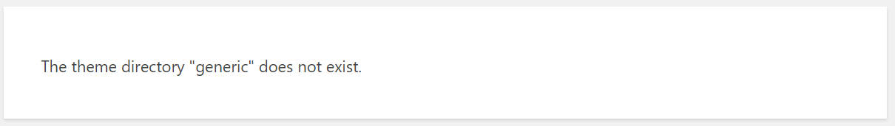
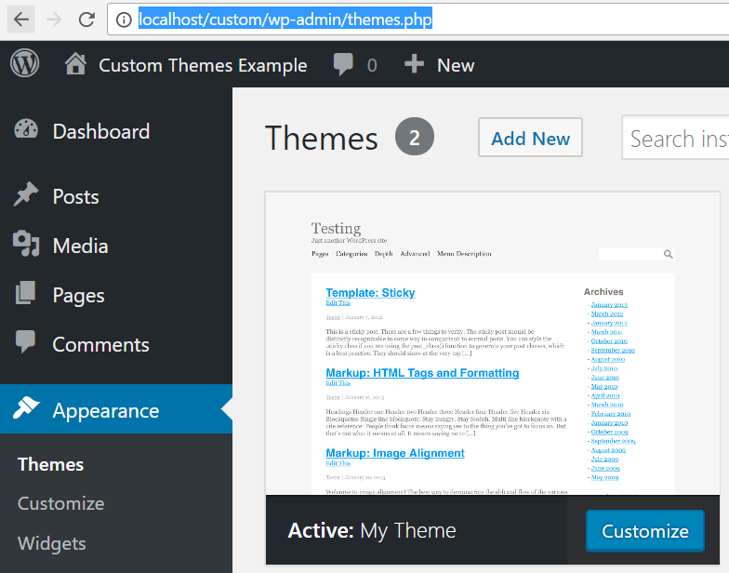
Activate the Renamed Theme
You may get the following error if you try to open your site
The active theme is missing
Open the admin panel /wp-admin/
Activate the renamed theme

Slide 18
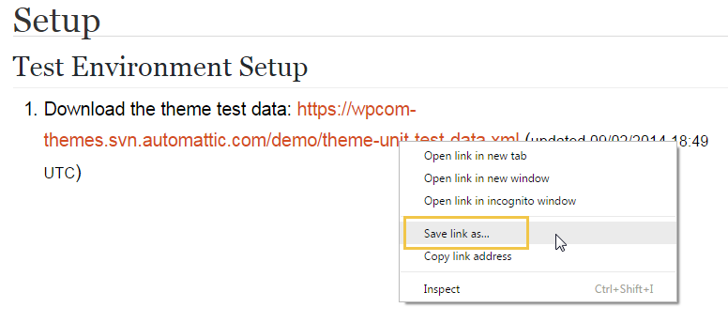

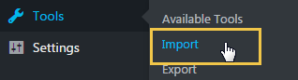
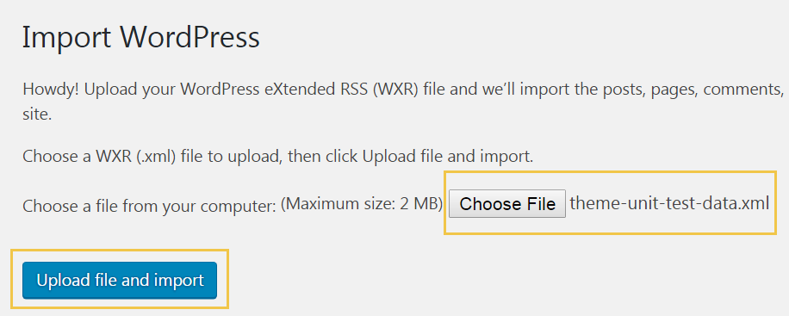
Import Demo Content
Download demo content from https://codex.wordpress.org/Theme_Unit_Test
Import the demo content

Slide 19
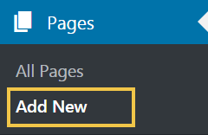
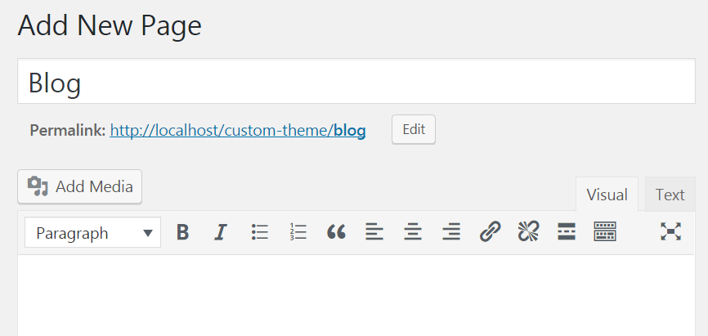
Create Pages
Create some pages

Slide 20
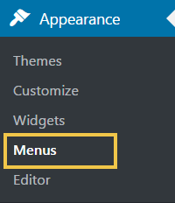
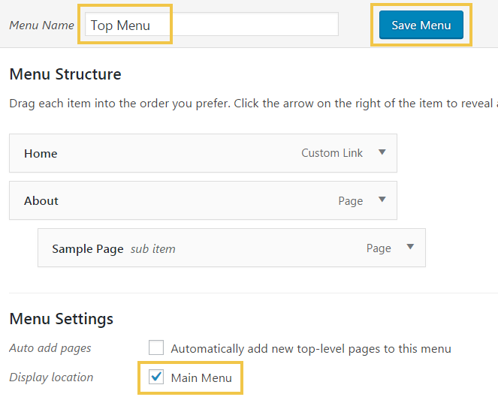
Create Menus
Create the top menu and attach it to the "Main Menu" location

Slide 21
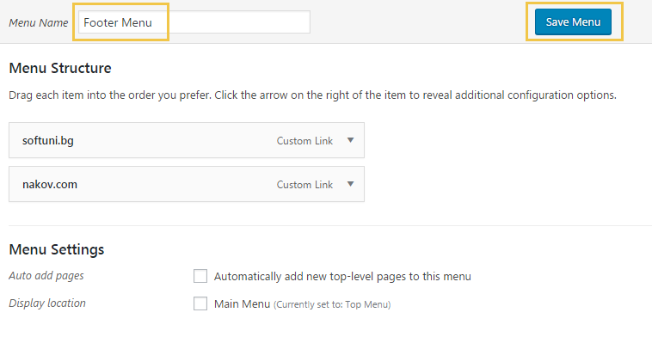
Footer Menu
Create a footer menu holding links (to be used later)

Slide 22
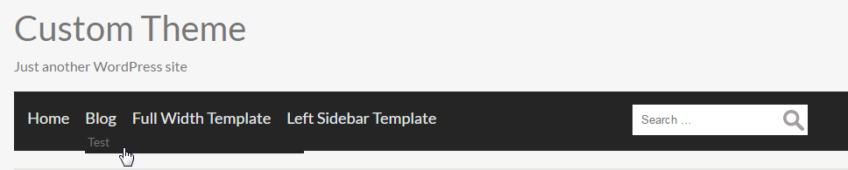
Customize the Theme CSS
Customize the theme look and feel in the style.css file

Slide 23
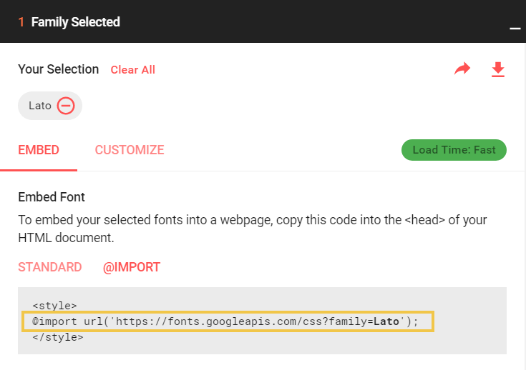
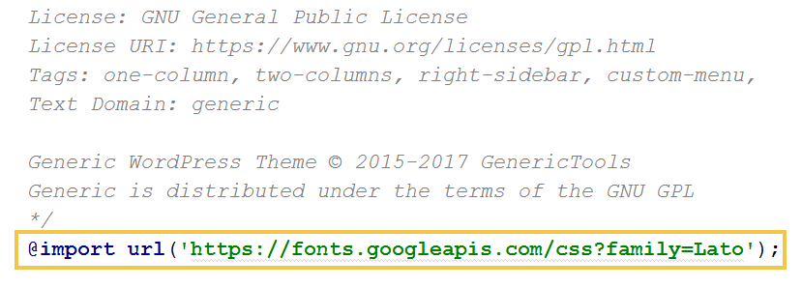
Change the Theme Font
Open style.css
Import the "Lato" font from https://fonts.google.com/specimen/Lato
Replace font-family in the CSS: "georgia" with "Lato"

Slide 24
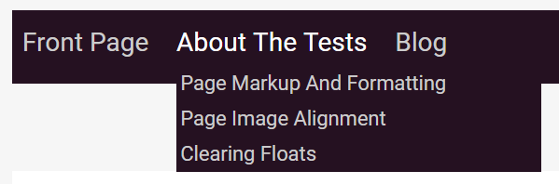
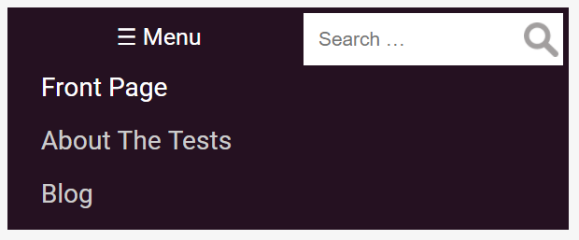
Change the Top Menu Color
Add the following CSS styles to your styles:
#menu, #menu ul li:hover ul li a {
border: 0;
background: #251121;
padding: 1%;
}
#menu #menu-short li a {
color: #ccc;
}
#menu #menu-short li a:hover {
color: #fff;
}

Slide 25
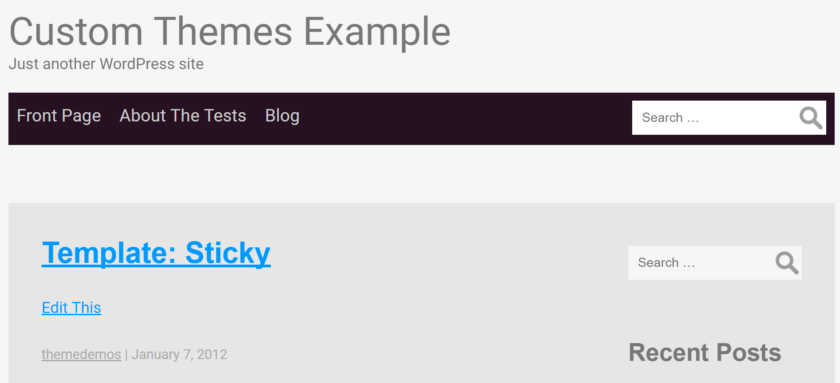
Main Background and Body Padding
Add the following CSS style to your styles:
Change the body padding
#container {
background: #e6e6e5;
margin: 0 auto 20px;
}
#wrapper {
max-width: none;
}
body {
padding: 1%;
}

Slide 26
Header and Navigation
Customize the header and navigation styles:
#site-title {
margin-bottom: 10px;
}
.search-box {
margin-right: 6%;
}
#branding {
margin-left: 9.5%; }
.menu-top-menu-container {
margin-left: 6%; }
#menu-top-menu.menu li:hover .sub-menu li a {
padding-left: 20px;
padding-top: 20px;
padding-bottom: 10px;
}

Slide 27
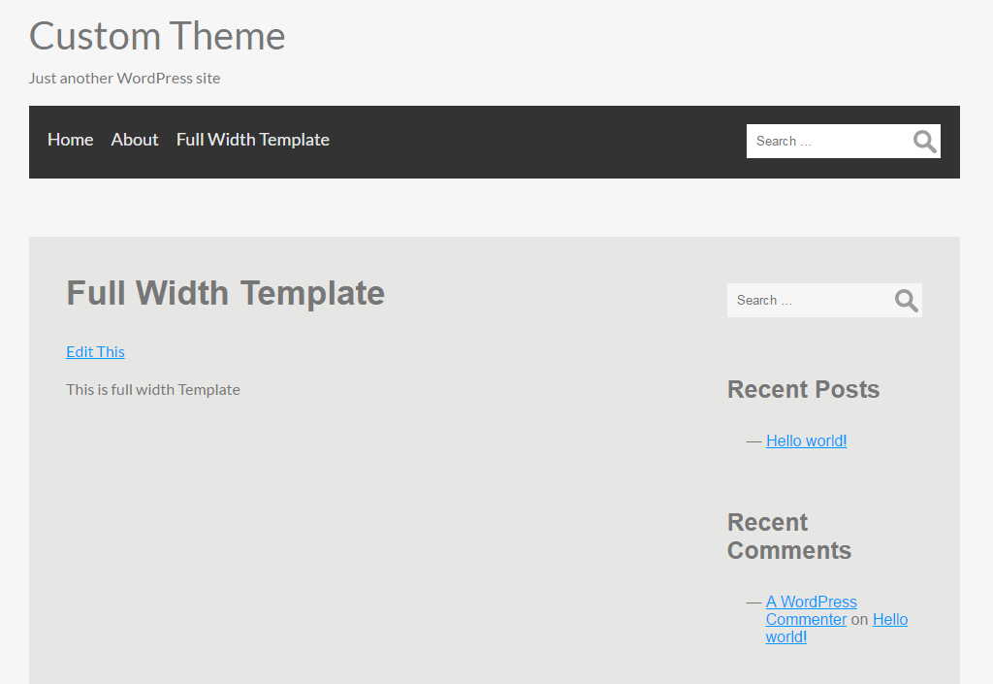
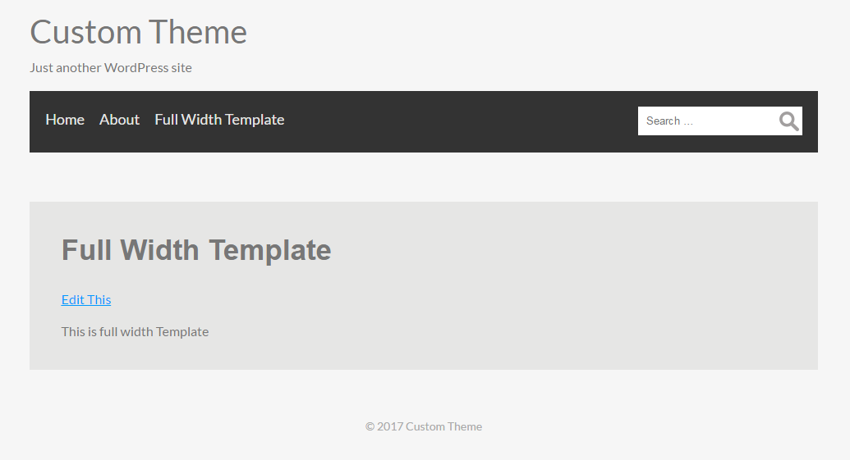
Creating Page Templates
page.php → page-full-width.php

Slide 28
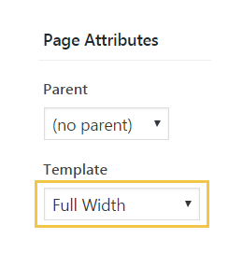
"Full-Width" Page Template: PHP Code
Copy page.php file into new file: page-full-width.php
Open page-full-width.php file and add the following code:
Add a CSS class "full-width":
Remove the sidebar: <?php> get_sidebar() ?>
Copy header.php → header-full-width.php
<?php /* Template Name: Full Width */ ?>
<main id="content" class="full-width">
<nav id="menu" class="menu">
<div id="container" class="header-full-width">

Slide 29
"Full-Width" Page Template: CSS Code
Add the "full-width" CSS styles into style.css:
#content.full-width {
width: 100% }
#container.header-full-width {
max-width: none;}
#branding.full-width-branding {
margin-left: 4%;}
#menu ul, #menu ul li {
margin-left: 1.2%;}
#menu.menu .menu-top-menu-container {
margin-left: 0;}

Slide 30
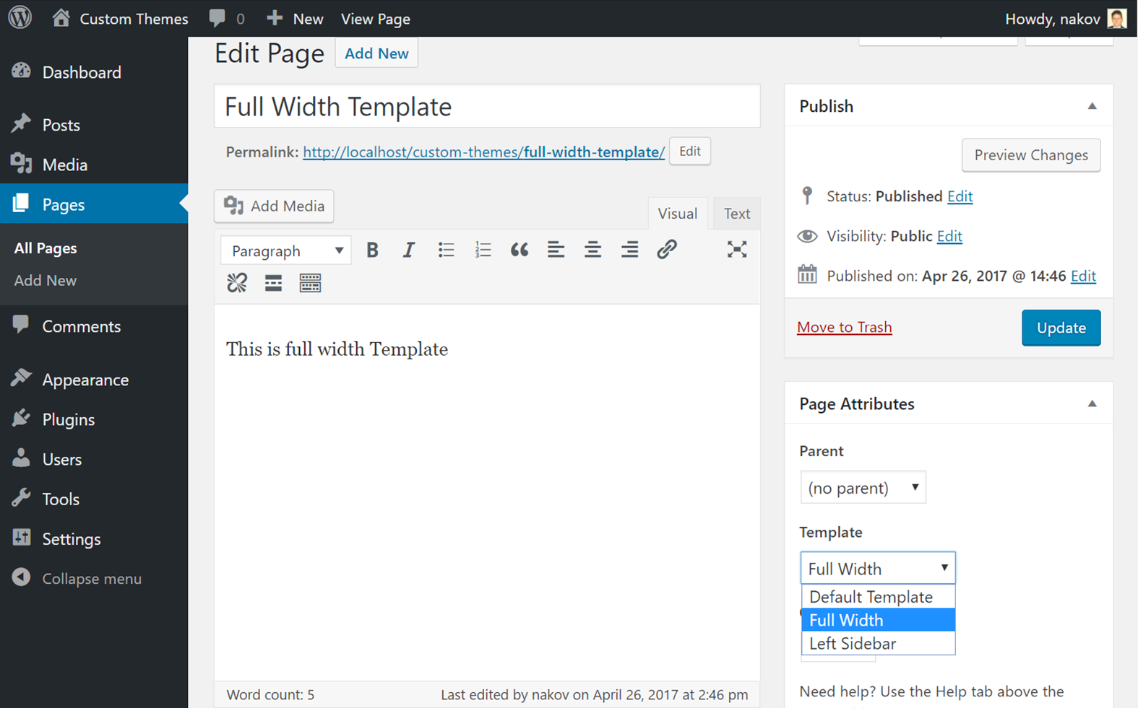
The "Full-Width" Page Template

Slide 31
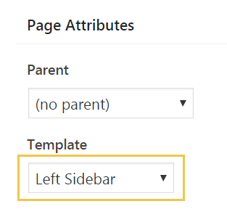
"Left-Sidebar" Page Template
Copy page.php → page-sidebar-left.php
Add in page-sidebar-left.php the following code
Add class "right-content":
Add <?php> get_sidebar('sidebar-left'); ?>
Copy sidebar.php → sidebar-left.php
Change:
<?php /* Template Name: Left Sidebar */?>
<main id="content" class="right-content">
<aside id="sidebar" class="left-sidebar">

Slide 32
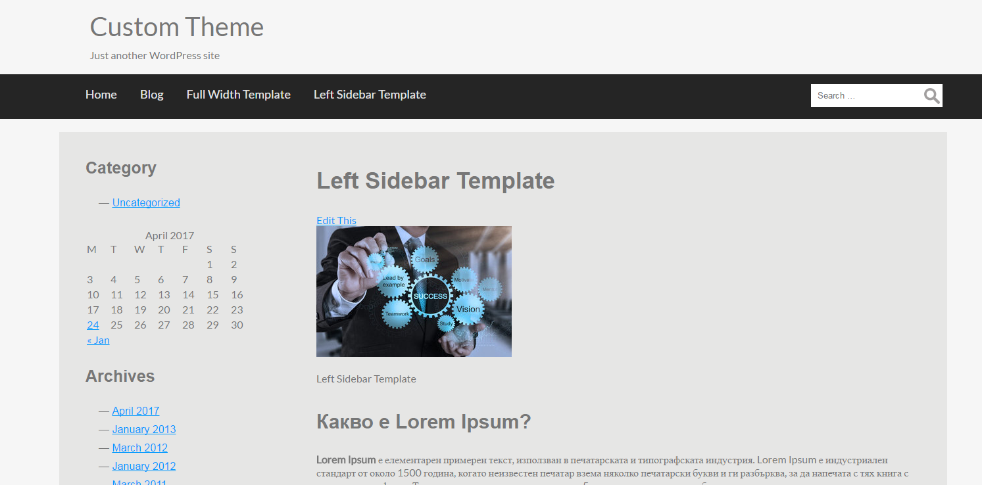
"Left Sidebar" Page Template: CSS
Add CSS styles for the "left-sidebar" pages
#sidebar.left-sidebar {
width: 25%;
padding: 3% 3%;
float: right;
}
#content.right-content {
float: right;
}

Slide 33
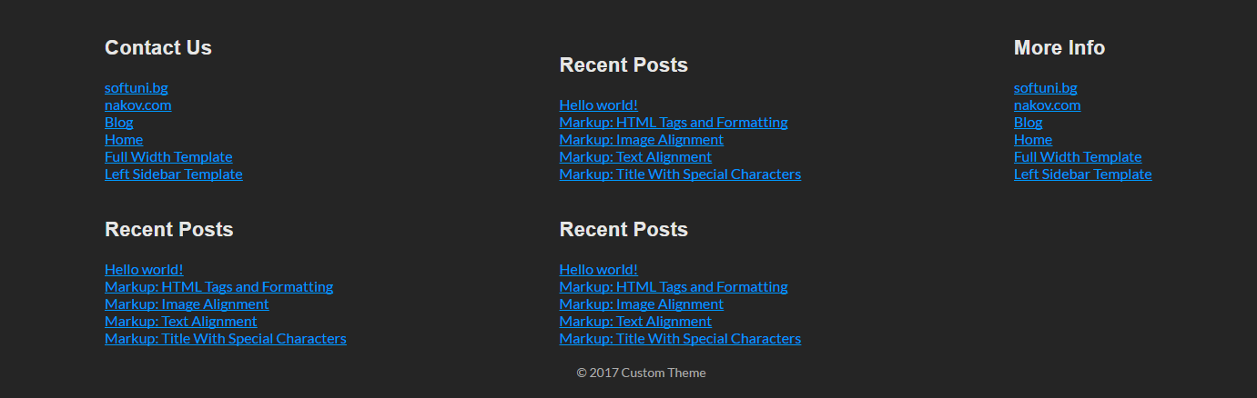
Creating Custom Widget Area
Additional Widgets in the Site Footer

Slide 34
Create Footer Widget Areas: Left Footer
Add some PHP code in the functions.php file:
function left_footer_widget() {
register_sidebar(array(
'name' => 'Left Footer',
'id' => 'widget-footer-area-1',
'before_widget' => '<div class="left-footer">',
'after_widget' => '</div>',
'before_title' => '<h3 class="footer-widget-title">',
'after_title' => '</h3>',
));}
add_action('widgets_init', 'left_footer_widget');
Widget #1
Widget #1
Widget #1
Widget #2
Widget #2
Widget #2
Widget #3
Widget #3
Widget #3

Slide 35
Create Footer Widget Areas: Middle Footer
Add middle_footer_widget() function:
function middle_footer_widget() {
register_sidebar(array(
'name' => 'Middle Footer',
'id' => 'widget-footer-area-2',
'before_widget' => '<div class="middle-footer">',
'after_widget' => '</div>',
'before_title' => '<h3 class="footer-widget-title">',
'after_title' => '</h3>',
));
}
add_action('widgets_init', 'middle_footer_widget');

Slide 36
Create Footer Widget Areas: Right Footer
Add right_footer_widget() function:
function right_footer_widget() {
register_sidebar(array(
'name' => 'Right Footer',
'id' => 'widget-footer-area-3',
'before_widget' => '<div class="right-footer">',
'after_widget' => '</div>',
'before_title' => '<h3 class="footer-widget-title">',
'after_title' => '</h3>',
));
}
add_action('widgets_init', 'right_footer_widget');

Slide 37
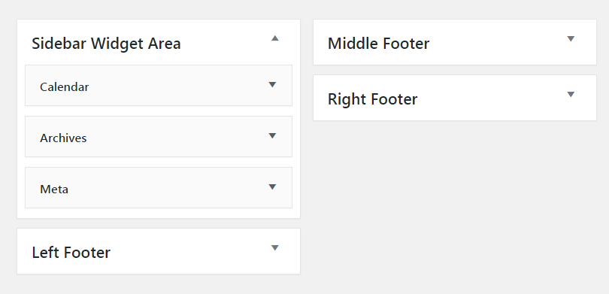
Add Widgets in the Footer Widget Areas
Go to [Dashboard] →[Appearance] →[Widget]

Slide 38
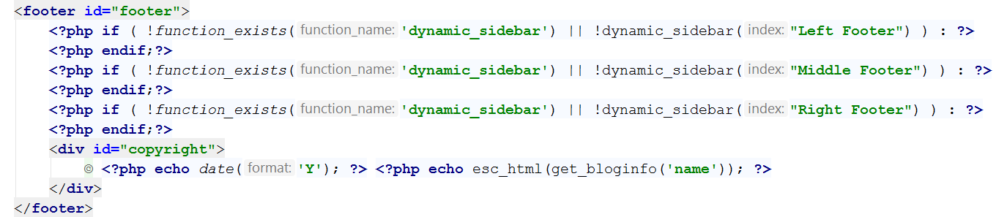
Display the Widgets in the Site Footer
Add some code in the footer.php:
<?php if ( !function_exists('dynamic_sidebar') || !dynamic_sidebar("Left Footer") ) : ?>
<?php endif;?>

Slide 39
Footer Widget CSS
Style the footer widgets in the site CSS:
.left-footer,
.middle-footer,
.right-footer {
width: 20%;
margin-left: 12%;
display: inline-block;
color: #E6E6E5;
}
.footer-widget-title {
font-size: 1.4em;
padding-top: 0;
margin-bottom: 20px;
}
#copyright {
padding-top: 20px;
padding-bottom: 20px;
}

Slide 40
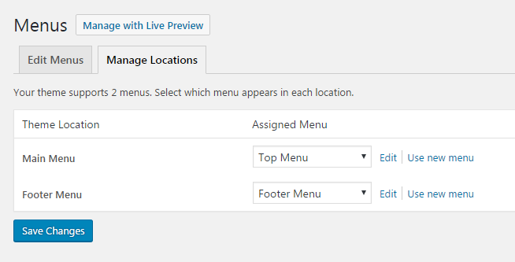
Creating Custom Menu Location
Additional Menus in the Theme

Slide 41
Creating Additional Footer Menu
Open functions.php and register a "footer-menu":
Display the footer menu in footer.php:
function custom_footer_menu() {
register_nav_menu('footer-menu', __('Footer Menu'));
}
add_action('init', 'custom_footer_menu');
<footer id="footer">
<nav id="menu-footer">
<label class="toggle-footer" for="toggle-footer">&#9776; Menu</label>

Slide 42
Footer Menu: Mobile View
Add some code for the mobile view of the footer menu:
Insert the provided footer-menu-styles.css code from resources
<input id="toggle-footer" class="toggle-footer" type="checkbox"/>
<?php wp_nav_menu(array('theme_location' => 'footer-menu')); ?>
</nav>

Slide 43

Summary
Create your own WP theme if ready-to-use themes do not fit
Use a starter theme to create your own WP theme
Basic HTML, CSS and PHP skills will be needed
Modify the header, footer, sidebar, page and post templates
Register widget areas and display them in the sidebars / footer
Register menu locations and display them as top menu / other menus

Slide 44







Custom WordPress Themes
https://softuni.bg/courses/wordpress-basics

Slide 45

License
This course (slides, examples, demos, videos, homework, etc.) is licensed under the "Creative Commons Attribution-NonCommercial-ShareAlike 4.0 International" license

Slide 46





Free Trainings @ Software University
Software University – High-Quality Education, Profession and Job for Software Developers
softuni.bg
Software University Foundation
softuni.org
Software University @ Facebook
facebook.com/SoftwareUniversity
Software University Forums
softuni.bg/forum

